Slide 1
Biodiversity for US National Parks
IDA Intensive Capstone

Slide 2
Natural Selection
The data provided has over 5800 entries with around 5500 unique species in the catalog
Categories include Mamalian, Avian, Reptilian, Amphibian, Pescataerian, and Plantae entries
Species have been grouped into four categories
“Species of Concern”, “Endangered”,”Threatened”, and “In recovery”
All null values are grouped into “No Intervention”
Counting Categories
conservation_status | scientific_name
Endangered | 15
In Recovery | 4
No Intervention | 5363
Species of Concern | 151
Threatened | 10

Slide 3
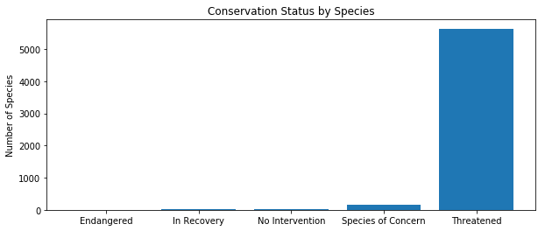
Visualizing the Biology

Slide 4
Statistical Significance Tests
Ultimately, one can group the categories of species between protected or not protected, filtering and narrowing down to two choices
Contingency tables were constructed to compute Chi Squared Tests
Tabulated values contain counts of each category of species and protection
Scipy Module used to compute with Python
Results:
Mammal v Bird | Reptile v Mammal | Bird v Fish v Mammal v Plant
False | True | True

Slide 5
0.08%
Average species protected among all cateogries

Slide 6
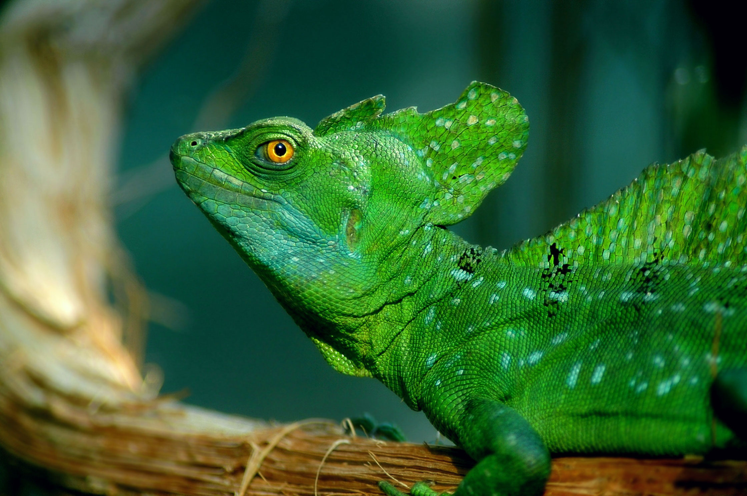
Recommendations
A higher percentage of mammalian species are protected than reptilian species, focus efforts on research and developing services.

Slide 7
How to determine sample size for a Disease study
Find Baseline percentage
-15% from known study at Bryce National Park
Determine Minimum Detectable Effect
Select a level of Significance
Calculate using Codecademy sample size calculator web link
Sample Size needed: 870
Weeks to observe full sample size at Bryce National Park and Yellowstone National Park based on weekly observations: 4 weeks at Bryce, 2 weeks at Yellowsone.

Slide 8
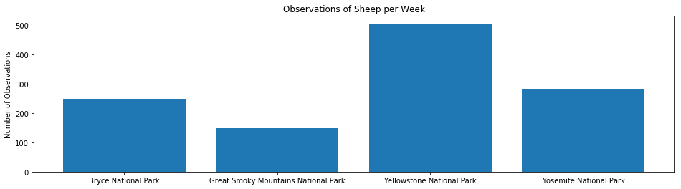
Conservationists at work

Slide 9
Thank you, notebook uploaded to Codecademy online

